Slide 1
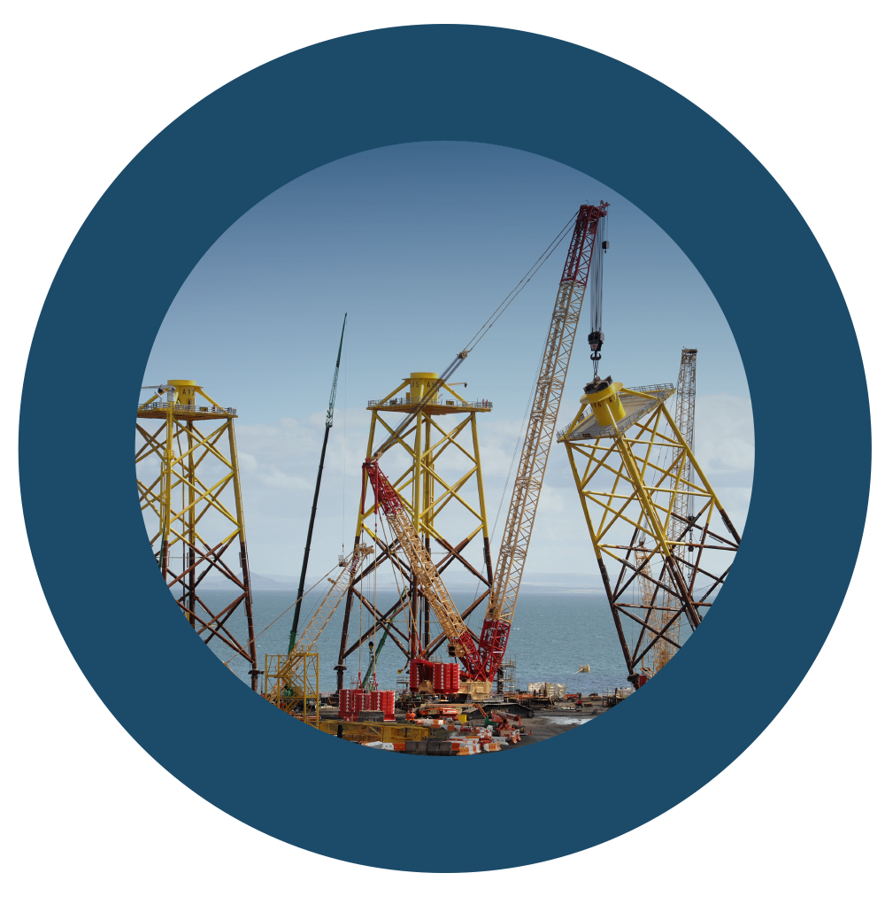


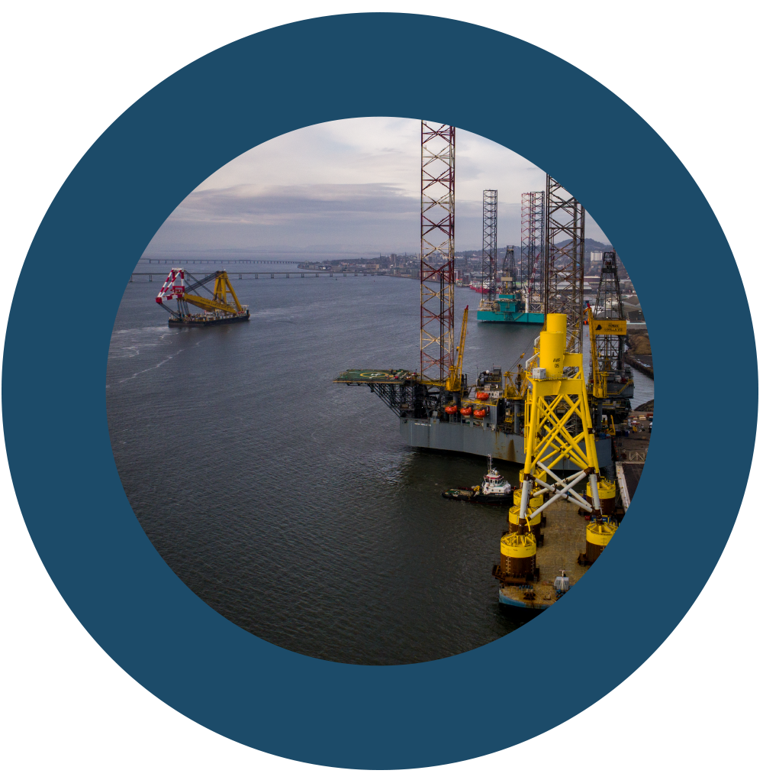






Growing Competitive, Collaborative and Innovative Supply Chains
Notes:
Welcome
Introductions
Agenda

Slide 2
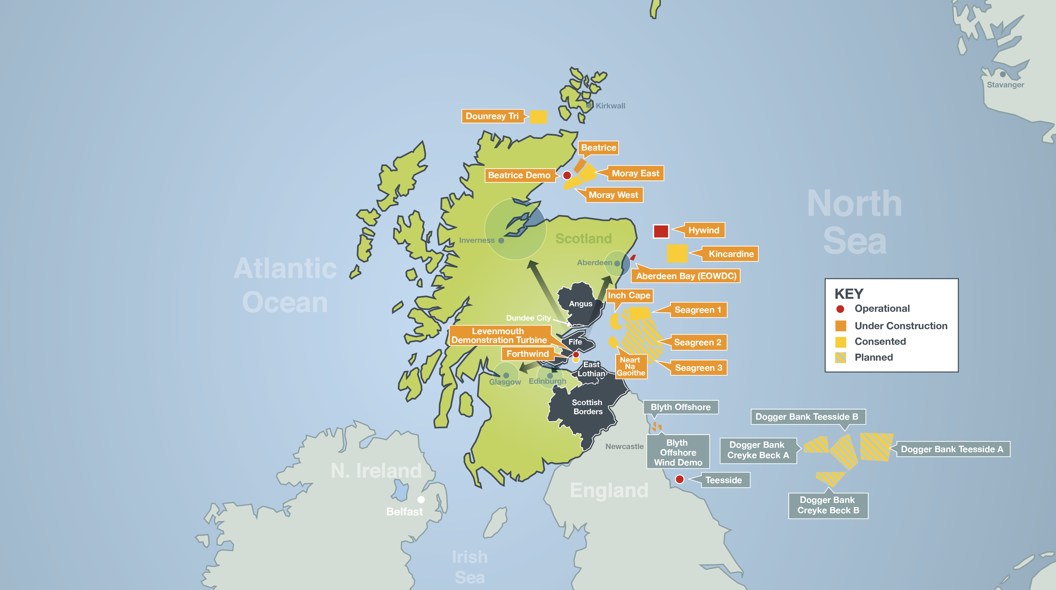


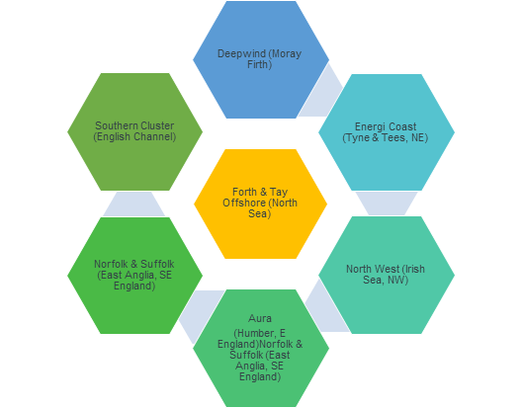

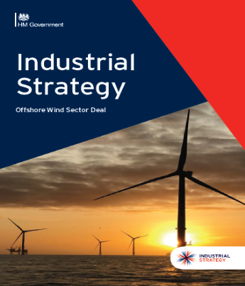

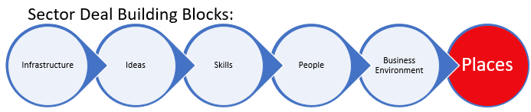
The world’s fastest growth region with a confirmed pipeline….
Places ~ “The deal proposes capitalising on naturally existing clusters and providing sector leadership to create more opportunities for investment and growth in local economies.”
Sofia Offshore

Slide 3
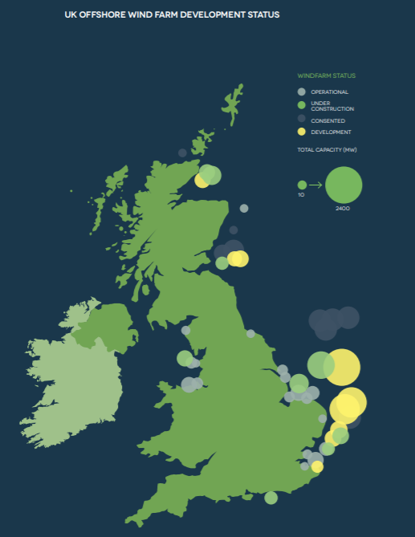
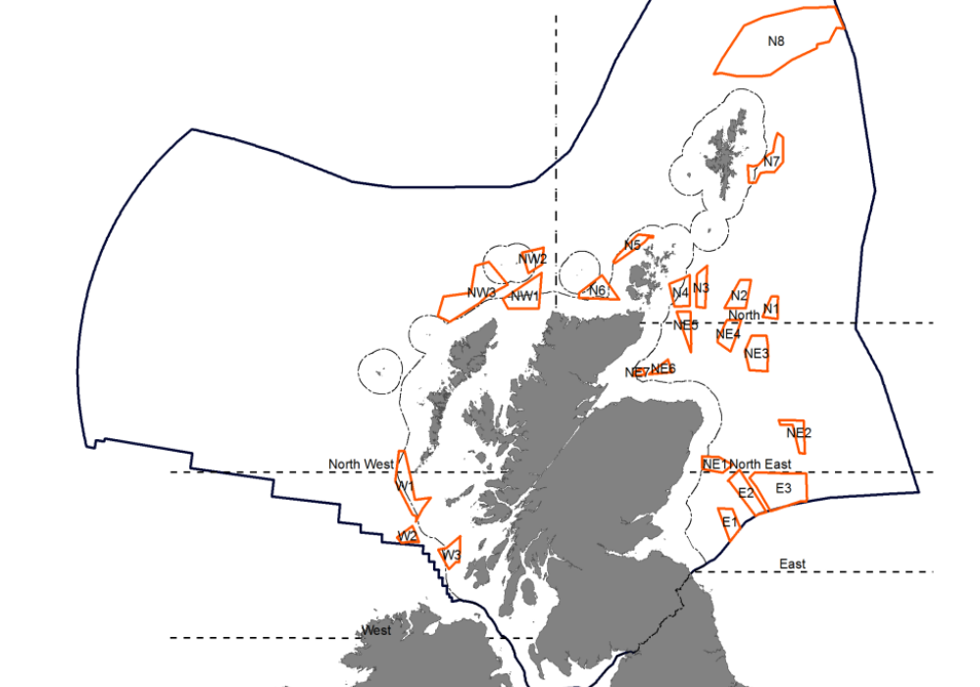
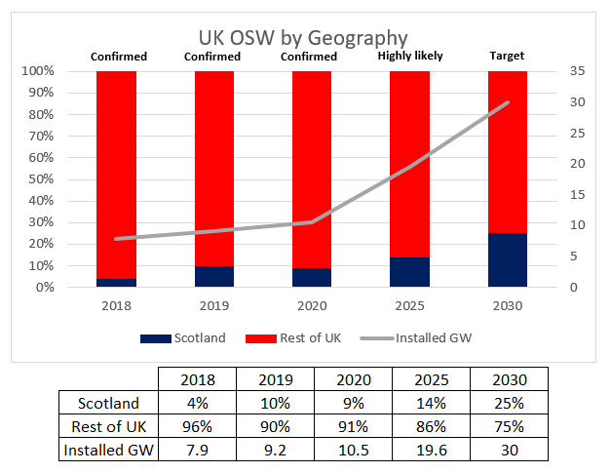
ScotWind and Round 4

Slide 4
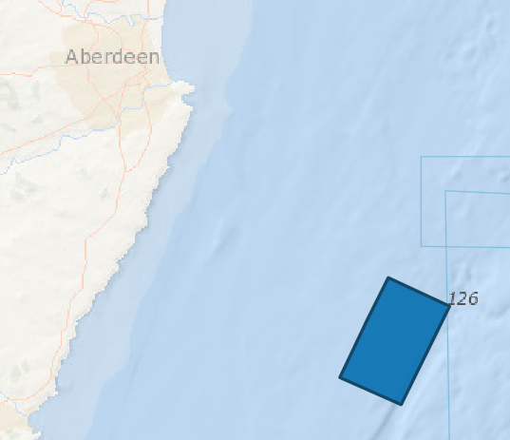
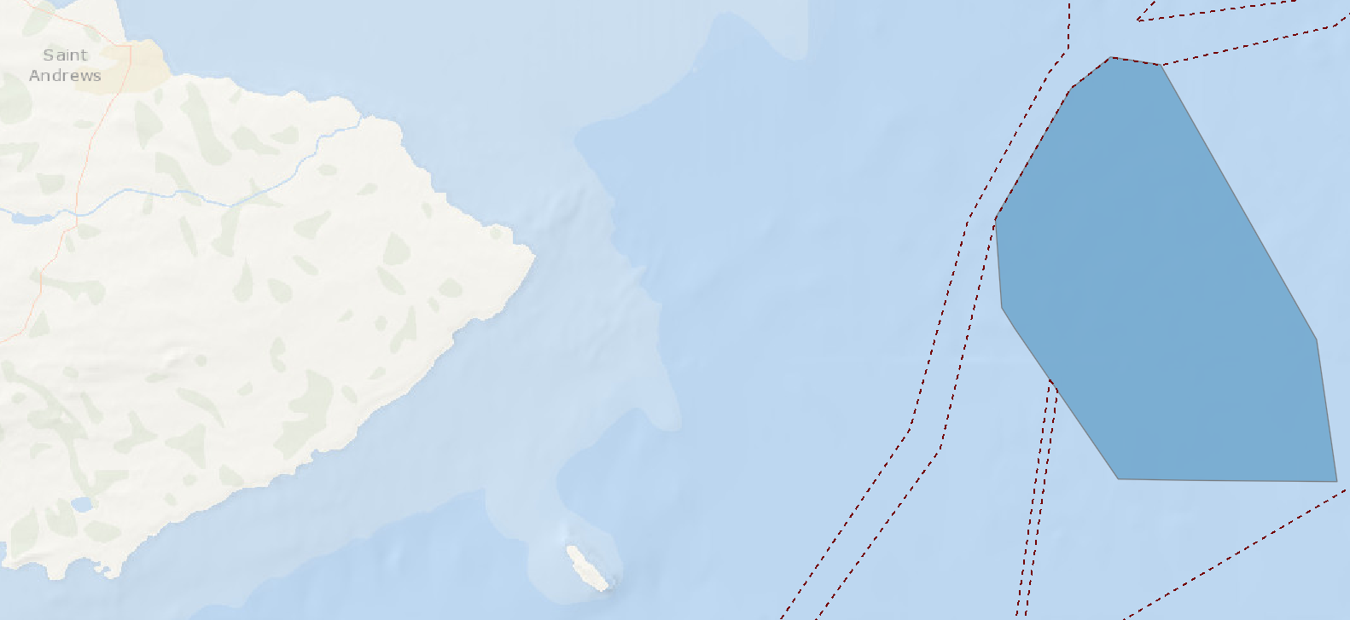
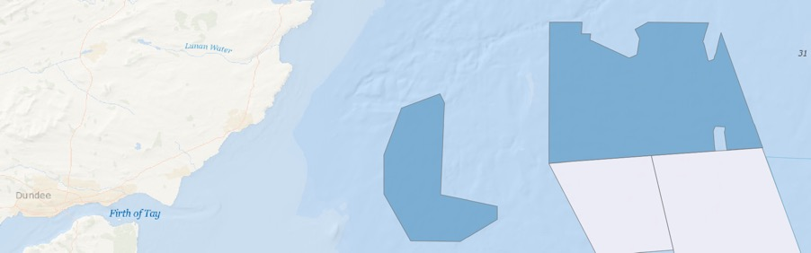
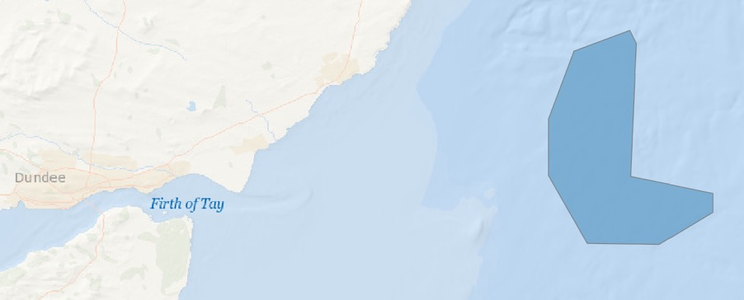
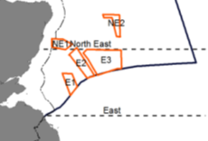
Forth & Tay potential to 2030
Developer: KOWL
Capacity: 50MW (6 turbines)
Distance to shore: 15km
Status: Site prep / Component manufacturing / Post-FiD
Known contractors:
Turbine ~ MVOW (9.5MW)
Foundations ~ Navantia (Floating)
Array cables: Prysmian
Export cables: Prysmian
Forecast online: 2020
Seagreen A&B
Neart na Gaoithe
Seagreen A&B
Crail
Developer: EDF Renewables
Capacity: 450MW (54 turbines)
Distance to shore: 16km
Status: Site prep / Post-FiD
O&M Base: Eyemouth (CTV)
Forecast online: 2023
Known contractors:
Turbines ~ SGRE (8.0MW)
Foundations ~ Saipem (Jackets)
Cables ~ Prysmian
Substation – GE Grid
Turbine Installation ~ Fred Olsen
Cable Installation ~ DEME
Developer: SSE
Capacity: 1075 of 1500MW (max 150 turbines) successful in 2019 CfD 3 auction
Distance to shore: 27km
Status: Site prep / Pre-FiD
O&M Base: Montrose (SOV)
Forecast online: 2023
Known contractors:
Turbines ~ MVOW (9.5MW)
Cables - Nexans
Substation – Petrofrac
Kincardine
1.6GW by ’23 (11% of UK 14.1GW)
In Construction
Consented Pre-Construction
With a pipeline of 10GW+ in Firths of Forth & Tay, 4-5GW by ‘30 is not unrealistic (to 20% of UK total)
Inch Cape
Seagreen 2 & 3
Developer: Red Rock Power
Capacity: 784MW (to 1000MW))
Distance to shore: 15km
Status: Consented / Pre-CfD
Developer: SSE
Capacity: to 3250MW
Distance to shore: 15km
Status: Planning
Seagreen 2 & 3

Slide 5
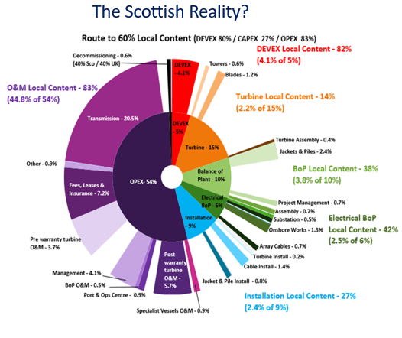

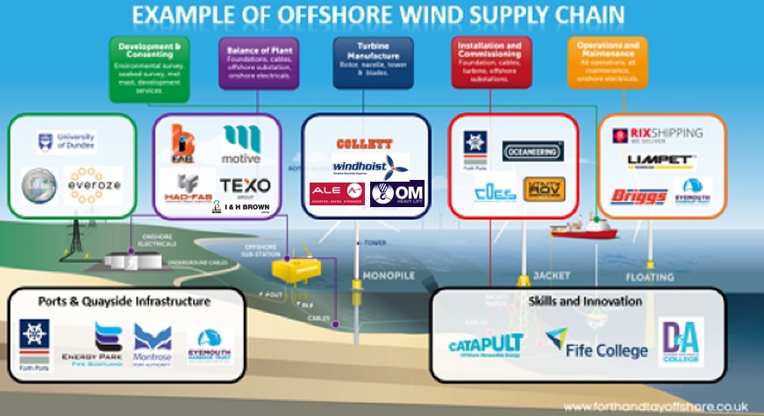
Why F&TO?
F&TO is a supply chain-led not-for-profit delivery workstream of the Scottish Offshore Wind Energy Council
Developers, Government, Enterprise Agencies, Local Authorities and Supply Chain are supporting the F&TO Cluster concept because:
It provides a consolidated ‘landing point’ for overseas tier 1 contractors coming to the region
It fosters collaboration and innovation by facilitating the identification of economies of scale
It provides a mechanism for enabling local infrastructure investment
It promotes an end-to-end lifecycle focus within the region:
Clusters ~ The Geographical Delivery Mechanism for Growing Competitive, Collaborative and Innovative Supply Chains
F&TO – Our 8 key responsibilities:
Signposting to expert and funding support
Link to regional innovation and research entities
Helping to shape regional skills and training initiatives
Showcasing local companies and regional capabilities
Facilitating buyer / seller interface
Providing sector news and routes to overseas markets
Strategic targeting of inward investors
Helping to develop local infrastructure business cases

Slide 6

Powering ahead in 2020
Q4 2019 ~ F&TO Launch Roadshow: we will be back in touch with the 150 expressions of interest
Jan’20 ~ Scottish Cluster Event: Additional companies coming forward
Mar’20 ~ Delivery Partner NnG MTB: Over 300 companies already signed up
Mar’20 ~ OSW for Newbies: Supply chain-led networking events anticipated throughout the year
2020 ~ Business development & Learning: Series of inward delegation visits and supply sub-element deep-dive workshops to be announced
2020 ~ Second draft of the UK’s most detailed regional supply chain map to be issued; F&TO playbook, website rework and regional capability case studies to be developed
2020 ~ Continue to play a key role in the OWIC-sponsored UK Cluster Group; collaborating via corridors of trade
2020 ~ Planning ongoing for representing regional capabilities at All Energy, Global Offshore Wind and Offshore Europe; marketing F&TO regional capabilities
F&TO – Firing turbines intae the water near the Home of Golf

Slide 7
Come and visit us at our stand today…. aland@scotiasc.co.uk https://www.forthandtayoffshore.co.uk/contact/
Notes:
Welcome
Introductions
Agenda

